Slide 1


Economic and Housing Outlook for 2016
Dr. James P. Gaines
Chief Economist

Slide 2
Happy New Year!!
The morning after the zoo’s Christmas party …

Slide 3


Slide 4


Slide 5


Slide 6


Slide 7
The 2016 Global and U.S. Economies

Slide 8
Global Outlook
Europe, China, India, Russia, Southeast Asia and South America all slowing or in recession
Capital flight to U.S., especially treasury securities and real estate
Foreign currency devaluations, officially or not, making dollar higher and our exports much lower
Global energy still unbalanced leading to sustained lower oil and gas prices
Continuing (escalating?) political-military unrest

Slide 9
U.S. Outlook
Slow growth the “new norm” – 2014 & 2015 +2.4%; 2016 expected GDP growth 2.4% - 2.7%
Interest rates will rise, slowly
Inflation not worrisome: 2016 1.5% - 2.0%, especially with lower energy & commodity prices
Industrial production and manufacturing little help
U.S. Housing improving, not fully recovered
Jobs expand ~2%; unemployment rate below 5.0%
No real “Driver” for expansion

Slide 10
Percent Change in Real GDP Since 1947
Average 3.4% rate of growth per year 1947-2005
Source: BEA

Slide 11
U.S. Jobs
2013 + 1.7%
2014 +2.0%
2015 +2.1%
1999-2014 +7.6%!!
Sources: BLS, Real Estate Center at Texas A&M University
Notes:
2015 added ~238000+ jobs per month on average

Slide 12
U.S. Employment Change
(000s Jobs, SA)
Industry | Dec-14 | Dec-15 | Yr. Chg. | Yr. % Chg.
Total nonfarm | 140,592 | 143,242 | 2,650 | 1.9%
Mining and logging | 913 | 782 | -131 | -14.3%
Mining | 860 | 730 | -129 | -15.1%
Oil and gas extraction | 201 | 185 | -17 | -8.3%
Mining, except oil and gas | 207 | 192 | -15 | -7.3%
Support activities for mining | 451 | 354 | -98 | -21.6%
Construction | 6,275 | 6,538 | 263 | 4.2%
Manufacturing | 12,301 | 12,331 | 30 | 0.2%
Trade, transport. & utilities | 26,669 | 27,114 | 445 | 1.7%
Wholesale trade | 5,876 | 5,941 | 65 | 1.1%
Retail trade | 15,497 | 15,771 | 274 | 1.8%
Transport. & warehousing | 4,739 | 4,833 | 94 | 2.0%
Utilities | 558 | 569 | 11 | 2.0%
Information | 2,767 | 2,817 | 50 | 1.8%
Financial activities | 8,049 | 8,196 | 147 | 1.8%
Professional and business services | 19,439 | 20,044 | 605 | 3.1%
Education and health services | 21,718 | 22,373 | 655 | 3.0%
Leisure and hospitality | 14,948 | 15,367 | 419 | 2.8%
Other services | 5,611 | 5,679 | 68 | 1.2%
Government | 21,902 | 22,001 | 99 | 0.5%
Federal | 2,732 | 2,749 | 17 | 0.6%
State government | 5,079 | 5,113 | 34 | 0.7%
Local government | 14,091 | 14,139 | 48 | 0.3%
Sources: BLS; Real Estate Center at Texas A&M University

Slide 13
Household Employment
Since November 2007 +2%!!
Source: BLS, Haver Analytics

Slide 14
Unemployment Rate
Source: BLS, Haver Analytics

Slide 15
Inflation Remains Relatively Low
Consumer Price Index for All Urban Consumers: All Items
Source: BLS, Y/Y % change in index

Slide 16
Consumer Confidence Index
Texas
Expansion
Recession
U.S.
Source: The Conference Board (1985=100); Haver Analytics

Slide 17
Texas Economy
2016: A Transition Year

Slide 18
TEXAS’ CURRENT SITUATION
“The Future Just Ain’t What It Used to Be!”
Yogi Berra

Slide 19
Texas Outlook
Texas Economy is slowing down 2016 much slower
National economic expansion most positive factor
Energy sector downturn lagged impacts into ’16 &‘17
Global recession a growing downside risk
Job growth to diminish significantly in 2016
Population expansion continues, but will also slow
Local Growth Issues becoming more pressing, causing greater strain on state and local resources
State budget at $30/bl. much different than at $65/bl.
Favorable business tax and regulatory environment continues to be an advantage to Texas

Slide 20
Texas Leading Economic Index
Declining trend for 14 months
Source: Federal Reserve Bank of Dallas, 1987=100

Slide 21
Texas and U.S. Economic Growth
Annual Percent Change in Real GDP
Sources: BEA; Real Estate Center at Texas A&M University

Slide 22
Texas Annual Jobs
2012 2.9% increase
2013 3.0% increase
2014 3.1% increase
Sources: Texas Workforce Commission, Real Estate Center at Texas A&M University

Slide 23
Annual Employment Growth Rates for US and Texas
Texas
US
Source: BLS, Real Estate Center at Texas A&M University

Slide 24
Texas Metropolitan Areas Ranked by Employment Growth Rate November 2015
 |  | November | November |  | Percent
Rank | Metropolitan Area | 2015 | 2014 | Change | Change
1 | Austin-Round Rock | 964.2 | 928.1 | 36.1 | 3.9
2 | Dallas-Plano-Irving | 2,436.3 | 2,347.4 | 88.9 | 3.8
3 | San Antonio-New Braunfels | 999.5 | 964.2 | 35.3 | 3.7
4 | Beaumont-Port Arthur | 173.7 | 168.8 | 4.9 | 2.9
5 | McAllen-Edinburg-Mission | 254.9 | 247.9 | 7 | 2.8
6 | Victoria | 46.5 | 45.5 | 1 | 2.2
6 | Laredo | 102.7 | 100.5 | 2.2 | 2.2
8 | Lubbock | 141.8 | 138.9 | 2.9 | 2.1
8 | Odessa | 83.4 | 81.7 | 1.7 | 2.1
10 | Brownsville-Harlingen | 140.6 | 137.9 | 2.7 | 2.0
11 | Midland | 100.2 | 98.6 | 1.6 | 1.6
11 | El Paso | 302.7 | 298.0 | 4.7 | 1.6
 | TEXAS | 11,882.6 | 11,703.3 | 179.3 | 1.5
13 | Corpus Christi | 200.8 | 197.8 | 3 | 1.5
14 | Waco | 113.7 | 112.2 | 1.5 | 1.3
15 | Fort Worth-Arlington | 1,006.8 | 994.5 | 12.3 | 1.2
16 | Sherman-Denison | 46.1 | 45.7 | 0.4 | 0.9
17 | College Station-Bryan | 109.1 | 108.2 | 0.9 | 0.8
17 | Houston-Sugar Land-Baytown | 3,006.4 | 2,982.7 | 23.7 | 0.8
17 | Longview | 106.7 | 105.9 | 0.8 | 0.8
20 | Tyler | 100.9 | 100.2 | 0.7 | 0.7
21 | Amarillo | 118.6 | 118.0 | 0.6 | 0.5
22 | Abilene | 69.4 | 69.1 | 0.3 | 0.4
23 | Killeen-Temple-Fort Hood | 136.7 | 136.4 | 0.3 | 0.2
24 | San Angelo | 49.5 | 49.8 | -0.3 | -0.6
25 | Texarkana | 58.9 | 59.5 | -0.6 | -1.0
26 | Wichita Falls | 57.5 | 58.5 | -1 | -1.7
DPI + Austin + SA = 37% of total jobs
Sources: Texas Workforce Commission, Real Estate Center at Texas A&M University

Slide 25
Energy Summary
Oil Prices may not have bottomed yet:
  Global oil production increased
  Global oil demand not rapidly increasing even with rapidly-falling prices
Significant cut back in upstream capital spending on E&P, i.e., fewer wells drilled, but production increases
Cuts in energy employment probably not over
Hedges run out this Fall for 2015; futures prices converging to current price
Growing number of “DUCs” bode ill for future production shortages, e.g., if 4,000 @ 300bls/day = 1.2 million bls/day
Increased geo-political-military volatility among oil producing nations that need (require) $95-$100+ oil price
Notes:
China uses about 15% of global oil

Slide 26
Weekly Active Texas Rig Count & Price of WTI
Rigs (left)
WTI $/bl.
(right)
WTI $/bl (right)
Source: Baker Hughes; EIA

Slide 27
Current and Futures Price of WTI
Sources: EIA; Haver Analytics
Notes:
From Ali’s spread sheet sent 8/11/15

Slide 28
Bryan-College Station Economy

Slide 29
College Station-Bryan Population: 2010-2050
Year | Total Population
2010 | 228,660
2015 | 251,252
2020 | 278,843
2025 | 307,676
2030 | 337,071
2035 | 366,377
2040 | 398,066
2045 | 433,616
2050 | 472,029
220,777 or 88% increase 2015-2050
Sources: Texas State Demographers Office, 2000-2010 Projections; Real Estate Center at Texas A&M University

Slide 30
College Station-Bryan Employment by Industry
Sources: Texas Workforce Commission, Real Estate Center at Texas A&M University

Slide 31
B-CS Annual Jobs
Employment continues to expand
4.2% in 2013; 2.5% in 2014 and ~1.4% 2015
Sources: Texas Workforce Commission, Real Estate Center at Texas A&M University

Slide 32
B-CS Monthly Jobs
Sources: Texas Workforce Commission, Real Estate Center at Texas A&M University

Slide 33
Annual Job Growth Rates for US, Texas and B-CS MSA
Bryan-College Station
Texas
US
December 2015 unemployment rate 3.3% vs. 4.2% Texas & 4.8% U.S.
Source: BLS, TWC, Real Estate Center at Texas A&M University

Slide 34
B-CS Employment Change:
December 2014 to December 2015
Industry | December 2014 | December 2015 | Change | % Change
Total Nonfarm | 107,500 | 108,200 | 700 | 0.7%
Leisure and Hospitality | 14,000 | 14,400 | 400 | 2.9%
Manufacturing | 6,200 | 6,500 | 300 | 4.8%
Retail Trade | 12,700 | 12,900 | 200 | 1.6%
Education and Health Services | 10,400 | 10,600 | 200 | 1.9%
Wholesale Trade | 2,400 | 2,500 | 100 | 4.2%
Information | 1,400 | 1,500 | 100 | 7.1%
Local Government | 10,400 | 10,500 | 100 | 1.0%
Mining, Logging and Construction | 7,500 | 7,500 | 0 | 0.0%
Financial Activities | 3,800 | 3,800 | 0 | 0.0%
Other Services | 3,600 | 3,600 | 0 | 0.0%
Federal Government | 800 | 800 | 0 | 0.0%
State Government | 24,600 | 24,600 | 0 | 0.0%
Transportation, Warehousing, and Utilities | 1,900 | 1,800 | -100 | -5.3%
Professional and Business Services | 7,800 | 7,200 | -600 | -7.7%
Sources: Texas Workforce Commission, Real Estate Center at Texas A&M University

Slide 35
National Housing Market

Slide 36
Macro Housing Issues
Demographics: growing, shifting
Affordability: home prices vs. incomes
Lending: credit underwriting; “alternative” loans
Infrastructure: transportation, education, utilities
Development: Design, Density, Resources and Processes
Regulatory: lending; environmental; land use
  Federal
  State
  Local Growth Controls/Initiatives

Slide 37
2016 National Housing Market
Mortgage Rates: up ~0.5% over the year (4% 4.5%)
Household Formations: ~1.25 million
Rental Market: tight, low vacancies, higher rents
Owner Market: sales volume and prices up ~5%
  Increased first-timers, millennials more active
Single-family Rental: organized SF rental market with institutional owners
Home Construction: builders focused on design, density, resources and processes
Affordability: prices and rents increasing faster than incomes – eventual constraint on market

Slide 38
New and Existing SF Home Sales U.S.
Home Sales 000s
Home Sales 000s
Existing SF Home Sales
New SF Home Sales
Sources: US Census Bureau , NAR, SAAR
Notes:
Recessions
----------------------------------------------
Peak month Year Trough Year
Month
----------------------------------------------
November 1948 October 1949
July 1953 May 1954
August 1957 April 1958
April 1960 February 1961
December 1969 November 1970
November 1973 March 1975
January 1980 July 1980
July 1981 November 1982
July 1990 March 1991
March 2001 November 2001
----------------------------------------------
Source: National Bureau of Economic Research, Inc.,

Slide 39
NAHB HMI & SF Starts
Source: NAHB, Real Estate Center at Texas A&M University

Slide 40
Mortgage and Federal Funds Rate
Source: Federal Reserve Board; FHLMC; Haver Analytics; Real Estate Center at Texas A&M University
Notes:
(GS10 & MORTG )Average Contract Rate on Commitments for Fixed-Rate First Mortgages
(GS10 also on slide 84 & 87, update both) - Updated: 5/9/13 (Mo)

Slide 41
Local Housing Markets

Slide 42
Annual Texas Home Sales
Source: Real Estate Center at Texas A&M University

Slide 43
Texas Months’ Inventory
Inventory at extremely low level relative to market activity
Source: Real Estate Center at Texas A&M

Slide 44
Texas SF Building Permits
1990-2014 average 94,693/year
2014 +10%
2015 +4%
Source: US Census Bureau, Real Estate Center at Texas A&M

Slide 45
Texas Average & Median Home Prices
12-Month Moving Average
Since Jan 2012, average price is up 29% & median price is up 32%
Average Price
Median Price
Source: Real Estate Center at Texas A&M University

Slide 46
Texas Median HH Income & Median Home Price Indexed to 1989
Median Home Price
Nominal HH Income
Real HH Income
Source: U.S. Census Bureau; Real Estate Center at Texas A&M University

Slide 47
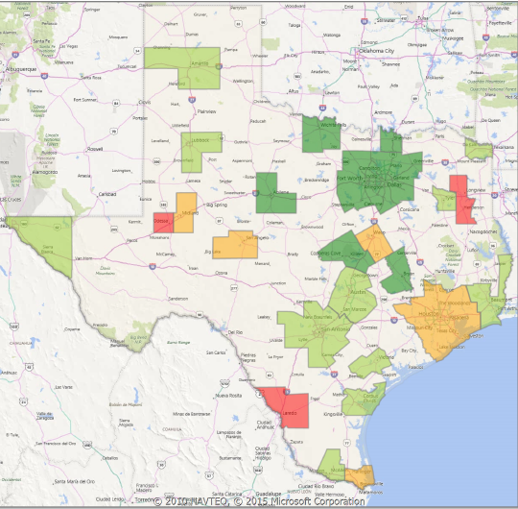
December Closed Sales Texas MSAs
Y/Y Percent Change
Dec. Sales +6%
YTD Sales +4%
Source: MetroTex; Texas Realtor® Data Relevance Project, Real Estate Center at Texas A&M University
Notes:
BCS SF down 2% YTD; -5% Y/Y

Slide 48
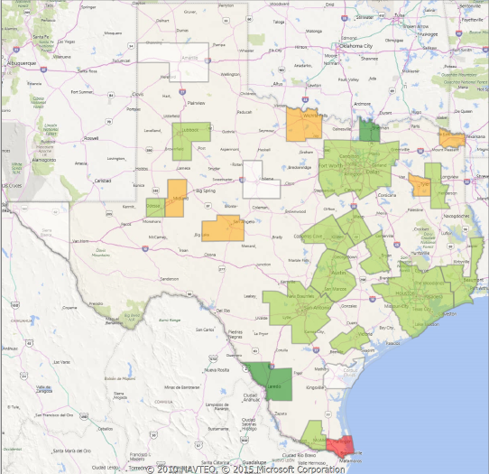
December Average Sales Price/Sq.Ft.
Y/Y Percent Change
Dec. P/SF +4%
YTD P/SF +6%
Md. Pr. YTD +7%
Source: MetroTex; Texas Realtor® Data Relevance Project, Real Estate Center at Texas A&M University

Slide 49
B-CS Annual Home Sales
Tremendous increase in sales volume since 2011
2012 +17.5%; 2013 +21%; 2014 +9.5%; 2015e +7.0%
Source: BCS Regional Association of REALTORS®; Real Estate Center at Texas A&M University

Slide 50
B-CS Median Home Prices
2013 median price +4%; 2014 + 6%
2015e +9.9%
Source: BCS Regional Association of REALTORS®; Real Estate Center at Texas A&M University

Slide 51
B-CS Months’ Inventory
Source: BCS Regional Association of REALTORS®; Real Estate Center at Texas A&M University

Slide 52
B-CS Median Home Price
12-Month Moving Average
Averaged about 0.34% per month or 4.1% per year appreciation since 1990
Source: BCS Regional Association of REALTORS®; Real Estate Center at Texas A&M University

Slide 53
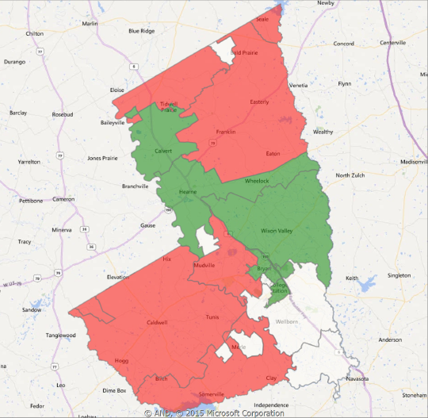

Home Sales by Zip Code, B-CS MSA
Y/Y % Change, December 2015
Hearne
Bryan
College
Station
Caldwell
Source: BCS Regional Association of REALTORS® Data Relevance Project; Real Estate Center at Texas A&M University
Navasota

Slide 54
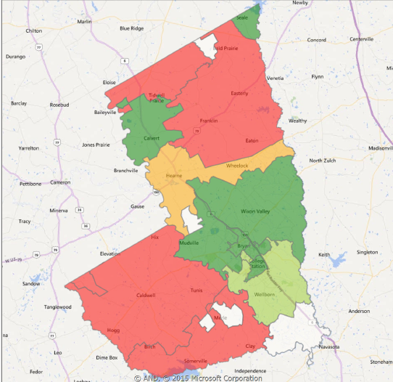
Home Sales Price/Sq. Ft. B-CS MSA by Zip Code
Y/Y % Change December 2015
Hearne
Bryan
College
Station
Caldwell
Source: BCS Regional Association of REALTORS® Data Relevance Project; Real Estate Center at Texas A&M University
Navasota

Slide 55
B-CS Single-Family Building Permits
2015e +15.4% Record Year!
Source: Real Estate Center at Texas A&M

Slide 56
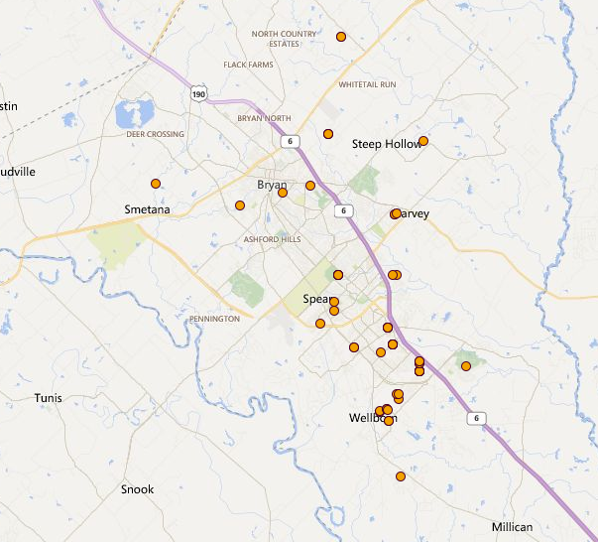
MLS New Home Sales Brazos County
December 2015
New Home Statistics, 2015
Month | Sales | Average Price | Y/Y % Price Change
January | 29 | $250,696 | 16.7%
Feb. | 29 | $273,426 | 21.4%
March | 39 | $257,285 | 9.8%
April | 47 | $290,601 | 9.0%
May | 61 | $268,471 | 5.6%
June | 50 | $266,730 | 0.2%
July | 95 | $242,076 | 7.9%
August | 101 | $235,099 | -15.4%
Sept. | 56 | $317,356 | 12.1%
Oct. | 27 | $286,362 | 3.2%
Nov. | 91 | $255,572 | 6.4%
Dec. | 57 | $274,432 | 0.5%
Bryan
College
Station
Source: BCS Regional Association of REALTORS® Data Relevance Project; Real Estate Center at Texas A&M University

Slide 57
B-CS Multi-Family Building Permits
2015YTD -53%
2-4 Units +74% to ~70 units;
5+ Units -59% to ~320 units
Source: Real Estate Center at Texas A&M (2-4 units + 5+ units)

Slide 58
Forecasting Is Tiring Work!
Gives New Meaning to “Dog Tired”

Slide 63
Thank You!!

Slide 64

7th Annual North Texas Realty Symposium
The Crowne Plaza Dallas Hotel
January 22, 2016
Economic and Housing Outlook for 2016
North Texas Chapter
Dr. James P. Gaines
Chief Economist
www.recenter.tamu.edu

